Slide 1
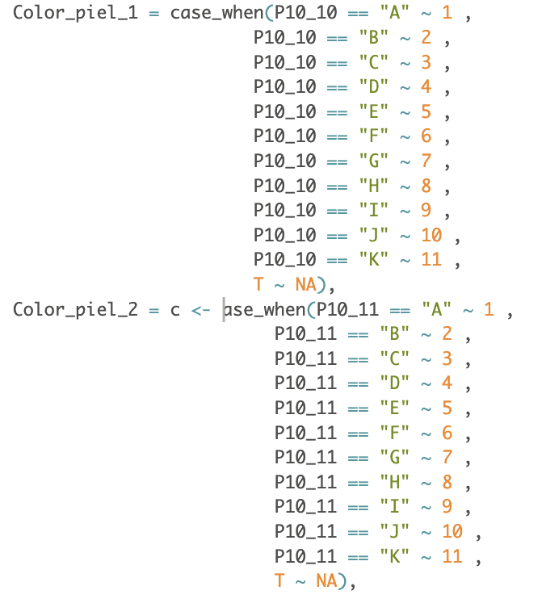
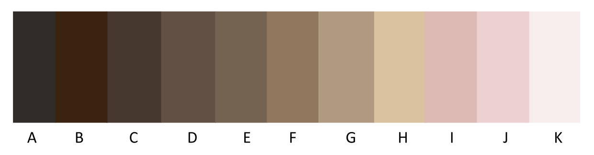
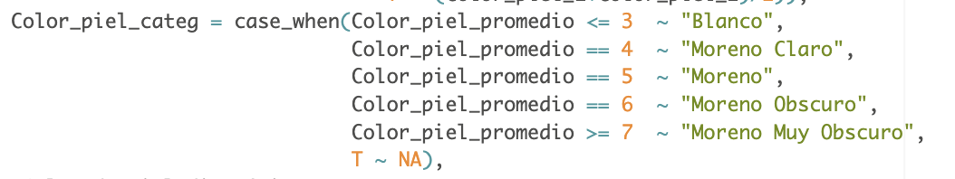
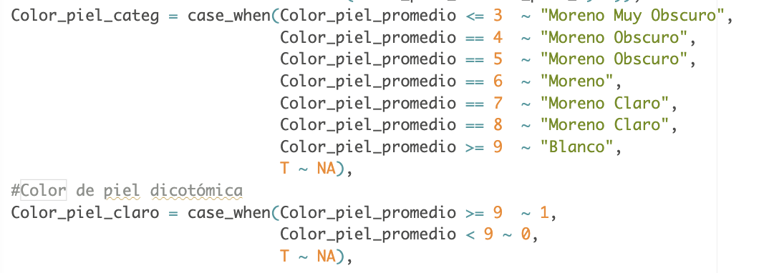
No blanco
Blanco
Moreno muy obscuro
Moreno obscuro
Moreno claro
Moreno claro
Blanco
(4, 6]
(6]
(7 ,8]
(9, 11]
[1 ,3]
1
2
3
4
5
6
7
8
9
10
11
Antes
4,481
4,481

